Slide 1

Airbnb Listing and Reviews Analysis
Prepared by - Kunal Malviya

Slide 2
Table of contents
01
Introduction
03
Goals & KPI
02
Recommended Analysis
04
Conclusion

Slide 3
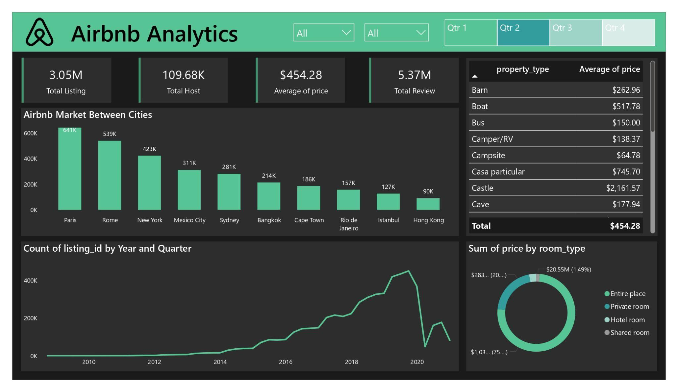

Slide 4
Problem Statement & Background
This case study analyzes Airbnb data for 250,000+ listings in 10 cities, covering hosts, pricing, locations, room types, and 5 million reviews. The aim is to identify market differences between cities, key factors influencing price, trends in reviews, and the best value city for travelers.

Slide 5
Goals & Kpi’s
The goal of this case study is to analyze Airbnb data to identify market differences between cities, key factors affecting pricing, trends in reviews, and determine which city offers the best value for travelers.

Slide 6

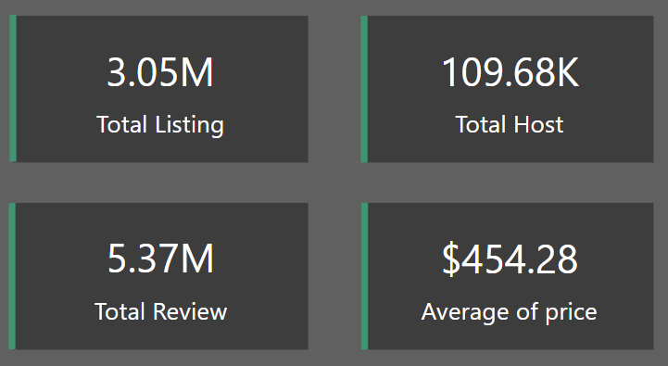
Kpi’s (Key Perfomance Indicator)

Slide 7
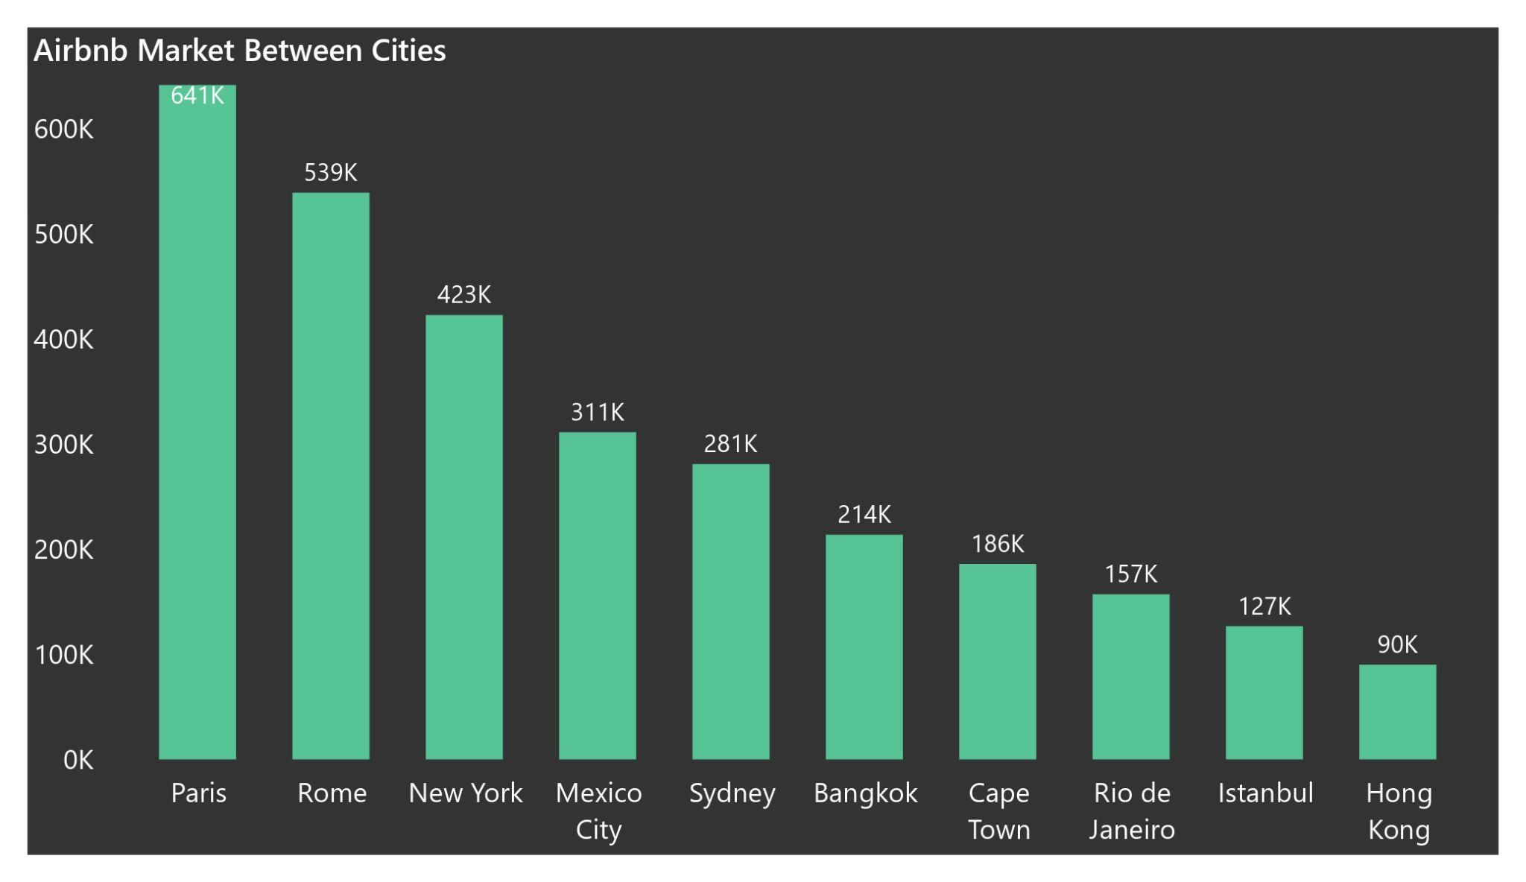
Recommended Analysis
Q.1 Can you spot any major differences in the Airbnb market between cities?

Slide 8
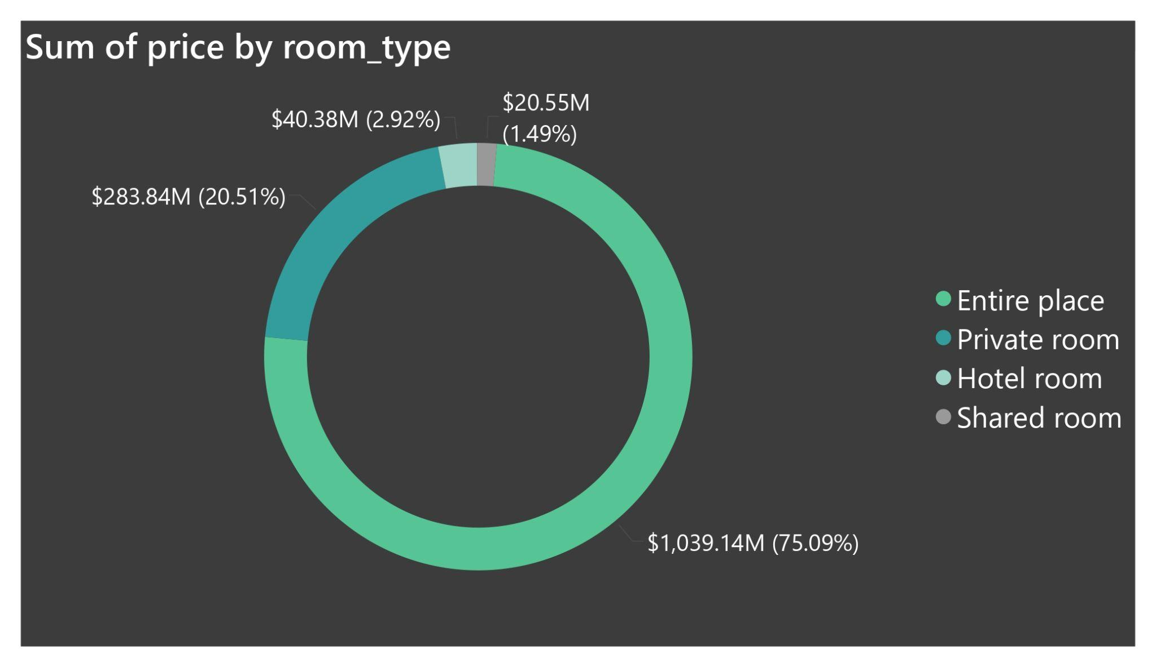
Q.2 . Which attributes have the biggest influence on price?

Slide 9
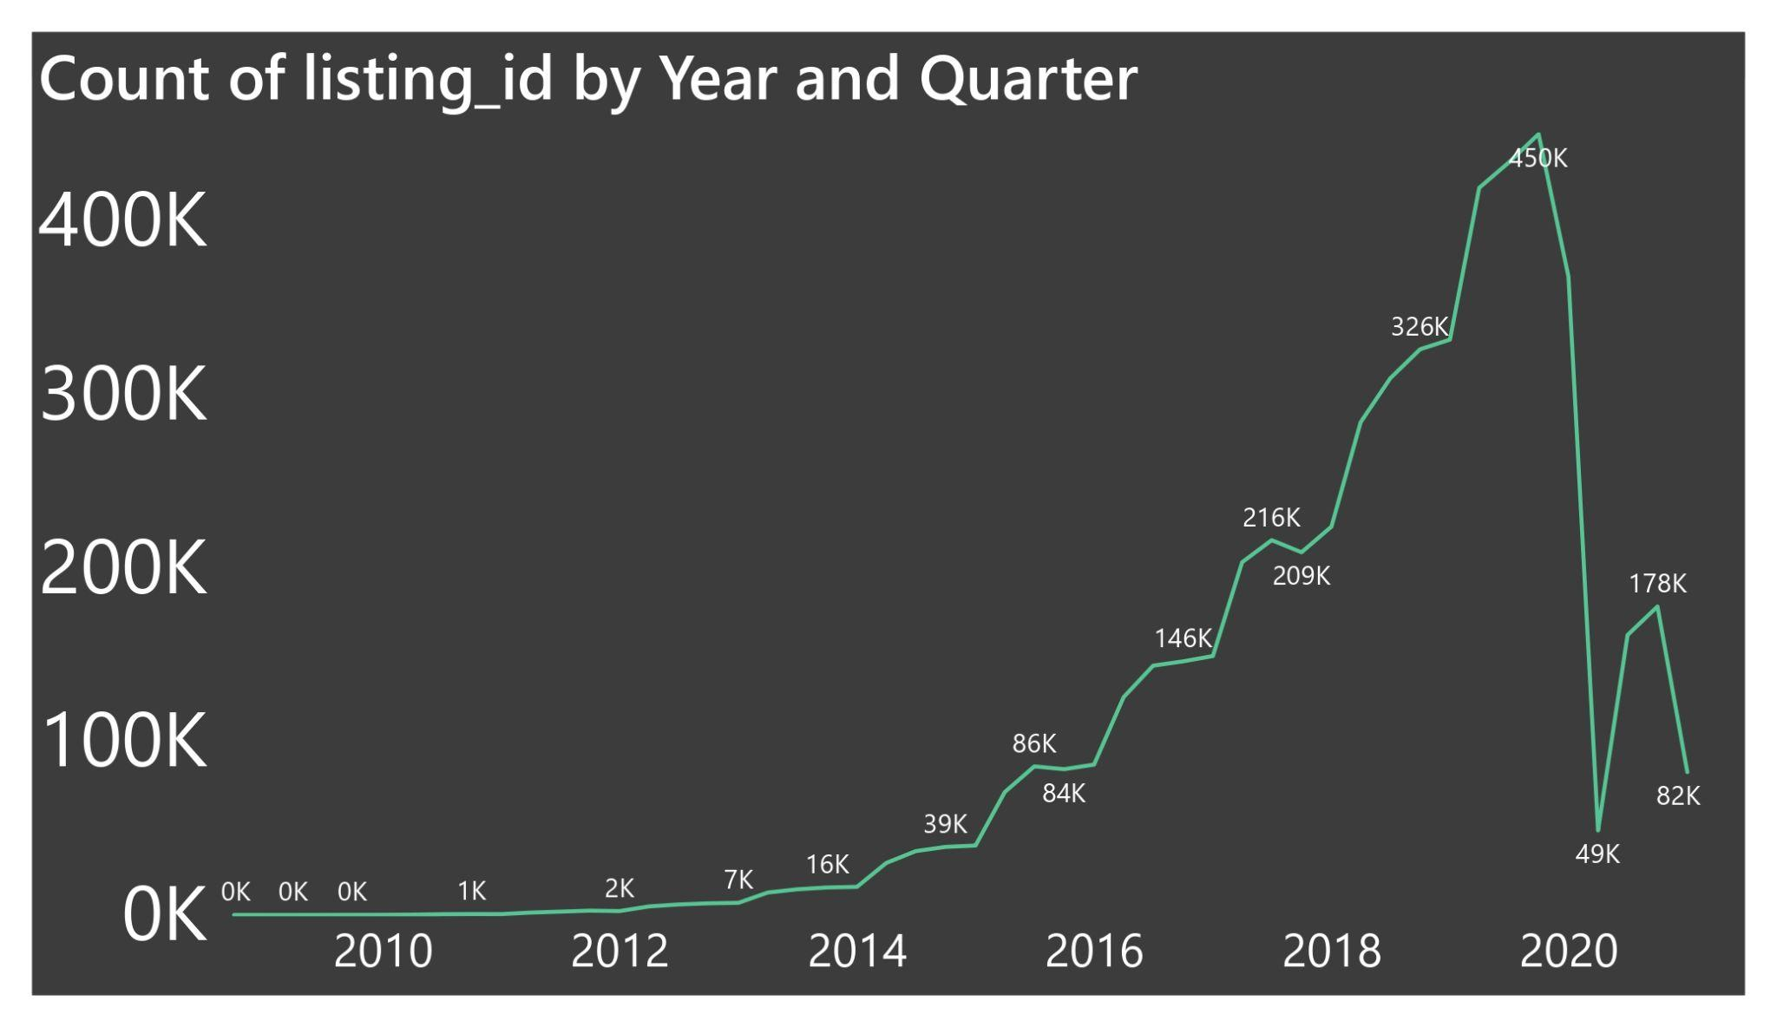
Q.3 . Are you able to identify any trends or seasonality in the review data?

Slide 10
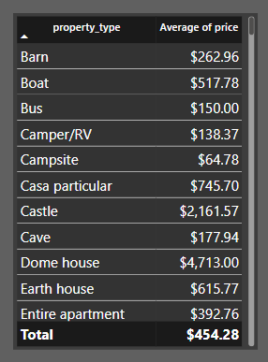
Q.4 FInd Out Properties Avg Price?

Slide 11

Conclusion
The Airbnb case study highlights significant differences across cities, with Paris, Rome, and New York having the highest number of listings. Property types like castles and "Casa particular" drive higher prices, while most revenue comes from entire place rentals. The market saw steady growth until a sharp decline post-2020. These insights can help inform pricing strategies, investment decisions, and traveler value assessments based on city and property type.

Slide 12

Thanks!
Does anyone have any questions?
Email - kunalmalviya558@gmail.com
Linkedin - Link
Portfolio - Link

